Slide 1




Weekly report: Storage System
7th week – 8th Presentation
Date: 11 /11/2025
Supervisor: Dr. Laurence Alhrshy
Group members: Mohamed Ahmed
11 /11/2025
Mohamed Ahmed
Storage System Team/ Optimus Syria
Notes:
`

Slide 2
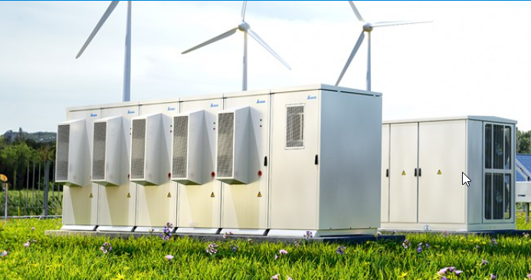
Content
Turkey as the Supplier Country
Supplier and Authorized Distributor
Storage Capacity Calculations
Product Specification
References
deltaww.com/en-US/index , 08/11/2025
11 /11/2025
2
Mohamed Ahmed
Storage System Team/ Optimus Syria

Slide 3
Turkey as the Supplier Country
As there are no local suppliers in Syria, I searched for alternatives in neighboring countries, and Turkey proved to be the most practical and reliable option.
  Geographical proximity to Syria enables easier land transport and lower logistics cost.
  Turkey has active Delta Electronics partners and service centers.
  Local authorized distributors such as Elkatek Elektronik provide technical and after-sales support.
  Easier customs handling and faster delivery times compared to overseas suppliers
11 /11/2025
Mohamed Ahmed
Storage System Team/ Optimus Syria

Slide 4
Local and Global Suppliers
  In Turkey, several local companies are active in the renewable energy and battery storage sector, including Elkatek Elektronik Ltd. Şti., Form Elektrik, Inavitas Energy Systems, and Kontrolmatik Technologies.
  Globally, leading companies in the energy storage market include Exide Industries Ltd., Delta Electronics, Inc., Amara Raja Group, AES Corporation, and Toshiba Corporation.
  Among these, Delta Electronics, Inc. was chosen for this project because it offers fully integrated, containerized lithium-ion energy storage systems equipped with BMS, HVAC, and fire protection systems.
11 /11/2025
Mohamed Ahmed
Storage System Team/ Optimus Syria

Slide 5


Supplier and Authorized Distributor
  Delta Electronics, Inc.
  Headquarters: Neihu, Taipei, Taiwan
  Delta Electronics is a global leader in Lithium-ion Battery Energy Storage Systems, utilizing advanced LFP (Lithium Iron Phosphate) technology.
  The company provides highly reliable, modular, and efficient storage solutions designed for grid-scale and industrial applications around the world.
  Authorized Distributor in Turkey
  Elkatek Elektronik Ltd. Şti. – Istanbul, Turkey
  Official Delta Electronics distributor providing sales, engineering support, and maintenance services for BESS projects across Turkey and the Middle East.
deltaww.com/en-US/index , 08/11/2025
elkatek.com/en/ , 08/11/2025
11 /11/2025
5
Mohamed Ahmed
Storage System Team/ Optimus Syria

Slide 6
Energy Curtailment and Storage Capacity Calculations
Curtailment Rate = 6% (NREL, Greening the grid, 2022)
Roundtrip effiency = 90% (Electronics, 2018)
Based on the previous presentation, the total annual energy production (AEP) is 17,520 MWh.
Using this value, the curtailed and storage energy calculations are as follows:
Curtailed Annual Energy = 17,520 × 0.06 = 1051.2 MWh
Average curtailed daily Energy = ​ = 2.88 MWh
Storage Capacity =
1051.2 MWh
365
2.88 MWh
= 3.2 MWh
0.9
11 /11/2025
Mohamed Ahmed
Storage System Team/ Optimus Syria

Slide 7
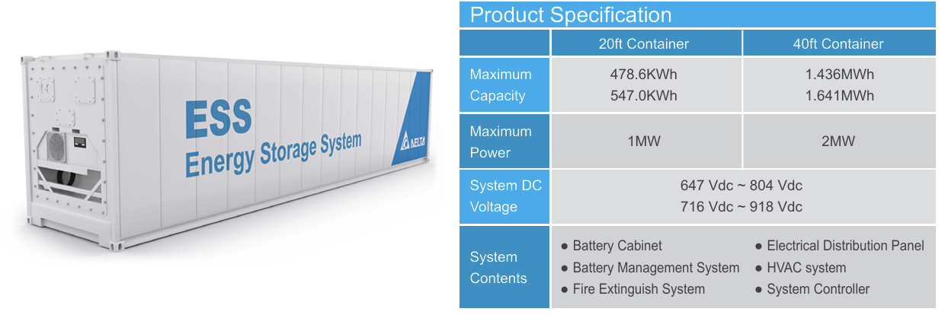
Product specification
Using two Delta 40 ft containers will be sufficient to accommodate the curtailed energy.
Each container provides a storage capacity of 1.641 MWh and a maximum power output of 2 MW, resulting in a total capacity of approximately 3.282 MWh
deltaww.com/en-US/products/Energy-Storage-Systems ,08/11/2025
11 /11/2025
7
Mohamed Ahmed
Storage System Team/ Optimus Syria

Slide 8
References
https://www.deltaww.com/en-US/index
https://www.elkatek.com/en/
11 /11/2025
Mohamed Ahmed
Storage System Team/ Optimus Syria

